Slide 1



Everyone should have Right to live.
Fatalities visualized: Palestine 2000-2023
Data Visualization Final assignment
By: Namood-e-Sehar

Slide 2
Introduction and Purpose
This is the alarming reality that the people of Palestine are facing challenges over half a century and now it has broken all its previous records. By examining the causalities, I aim to bring awareness to the toll that these incidents have taken on individuals and communities.
The purpose of this analysis is not only to present statistical figures but to humanize the data, recognizing the lives behind the numbers. Understanding the context of causalities is crucial for fostering empathy, encouraging informed discourse, and contributing to efforts aimed at lasting peace and stability in the region.
This study focusses on the years 2000 to 2023 , a period marked by significant geopolitical events and ongoing conflicts. By narrowing our focus to causalities, we aim to shed light on the human cost of these events, providing a comprehensive view of the impact on individuals and communities in Palestine.

Slide 3
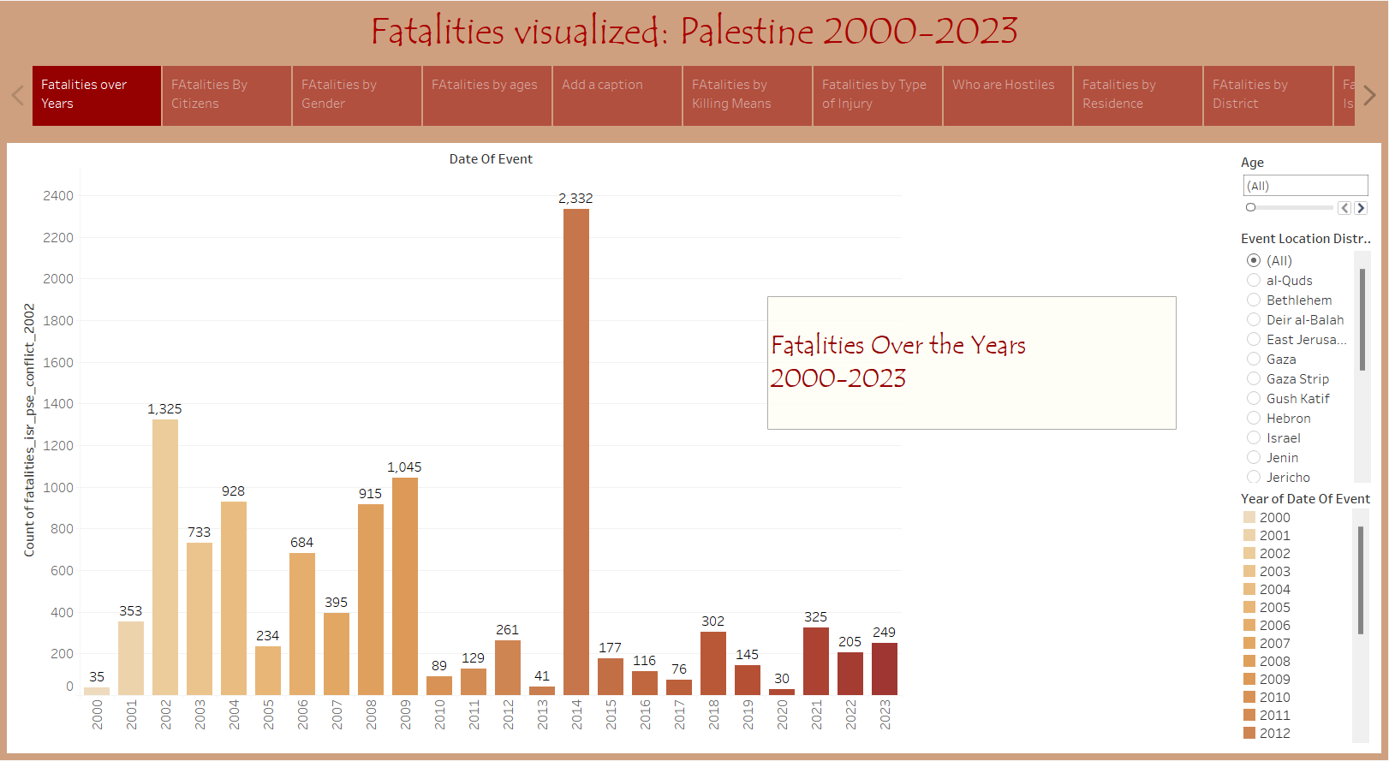
Fatalities Happen Over The Years
It all started with Israel taking over the remaining Palestinian lands in 1967 which then slowly resulted in the escalation of the conflict. Israeli's having greater military power attacked Palestinian territories and its people leading killings on an unprecedented scale.
The conflict itself has changed a lot over the years with the trend of the number of fatalities changing. Looking at the data the peak in fatalities is in 2014 with around 2,332 killings in one year. Overall, the killings have only increased, and the conflict has only escalated since 2000.
\

Slide 4
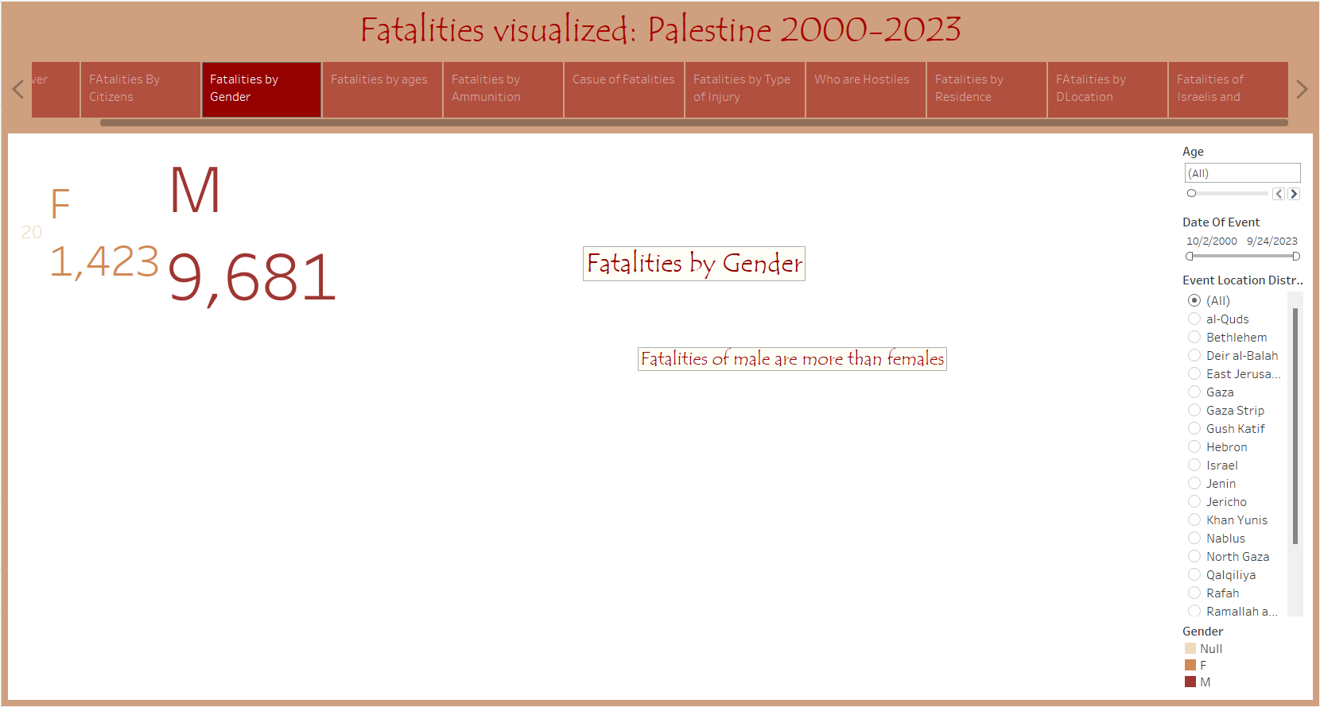

Fatalities Over The Years by Gender .
Furthermore, while females have been a target of these fatalities Palestinian men specifically have been a target of these killings.

Slide 5
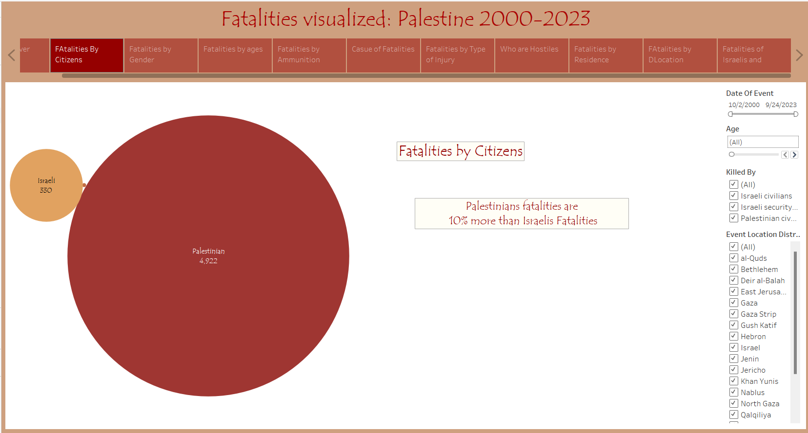
Fatalities Over The Years by Citizens
Palestine does not consist of Palestinians it also has Israelis, Americans and Jordanians that have been a target of Israeli bombing, but the difference is clear. Palestinian killings are far greater in number. Palestinian fatalities are 10% more than Israeli fatalities.

Slide 6
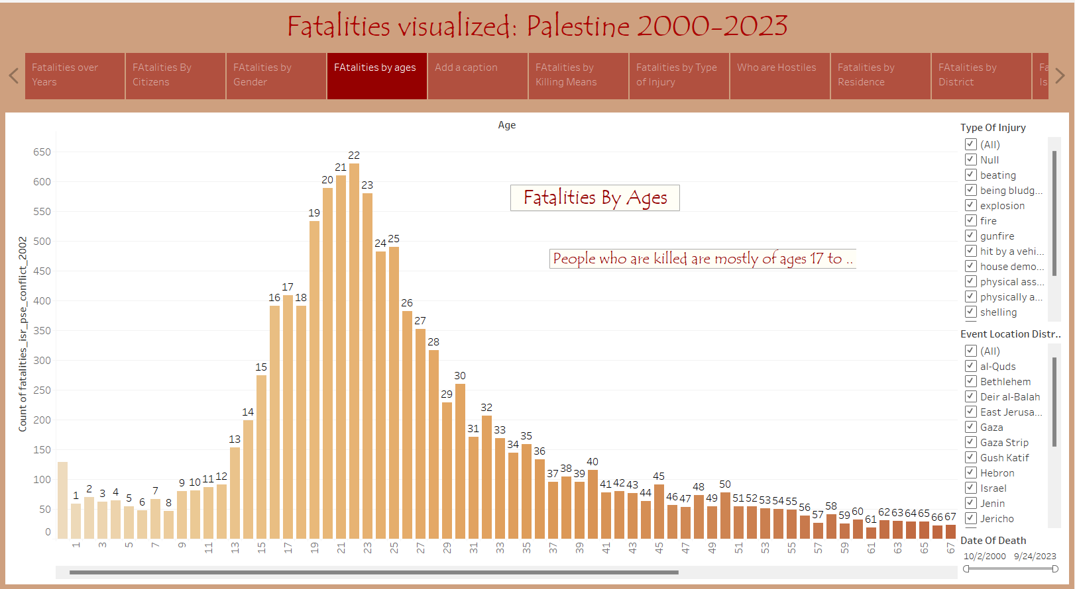
Fatalities are happened over The Years by Ages
Then it comes to ages. The target also seems to be specific to ages. The data shows that from 2000 to 2023 ages 17 to 25 have been the most killed by Israeli killings. These are young people who are most likely to not go past their 20s due to constant targeting.
:

Slide 7
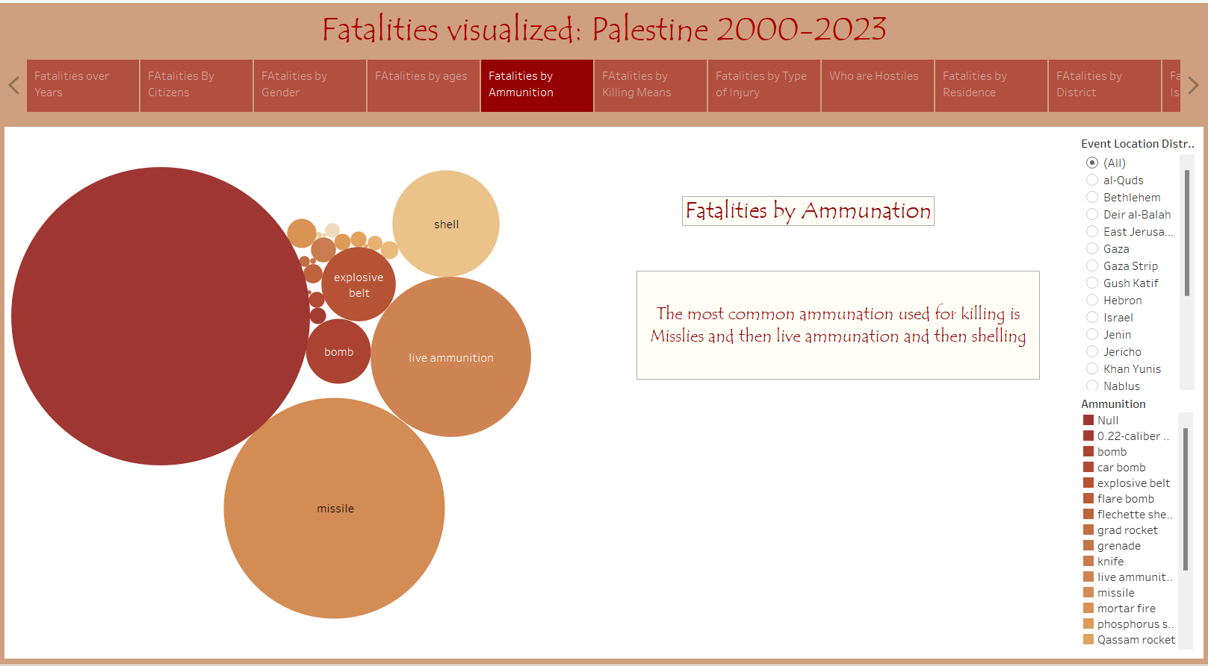
Fatalities Happen Over The Years by Means of Killing
In terms of the means of killing there are a number of ways Israeli forces use to kill Palestinian. Out of all of them missiles come on top with live ammunition and shelling bombs taking the second and third position.

Slide 8
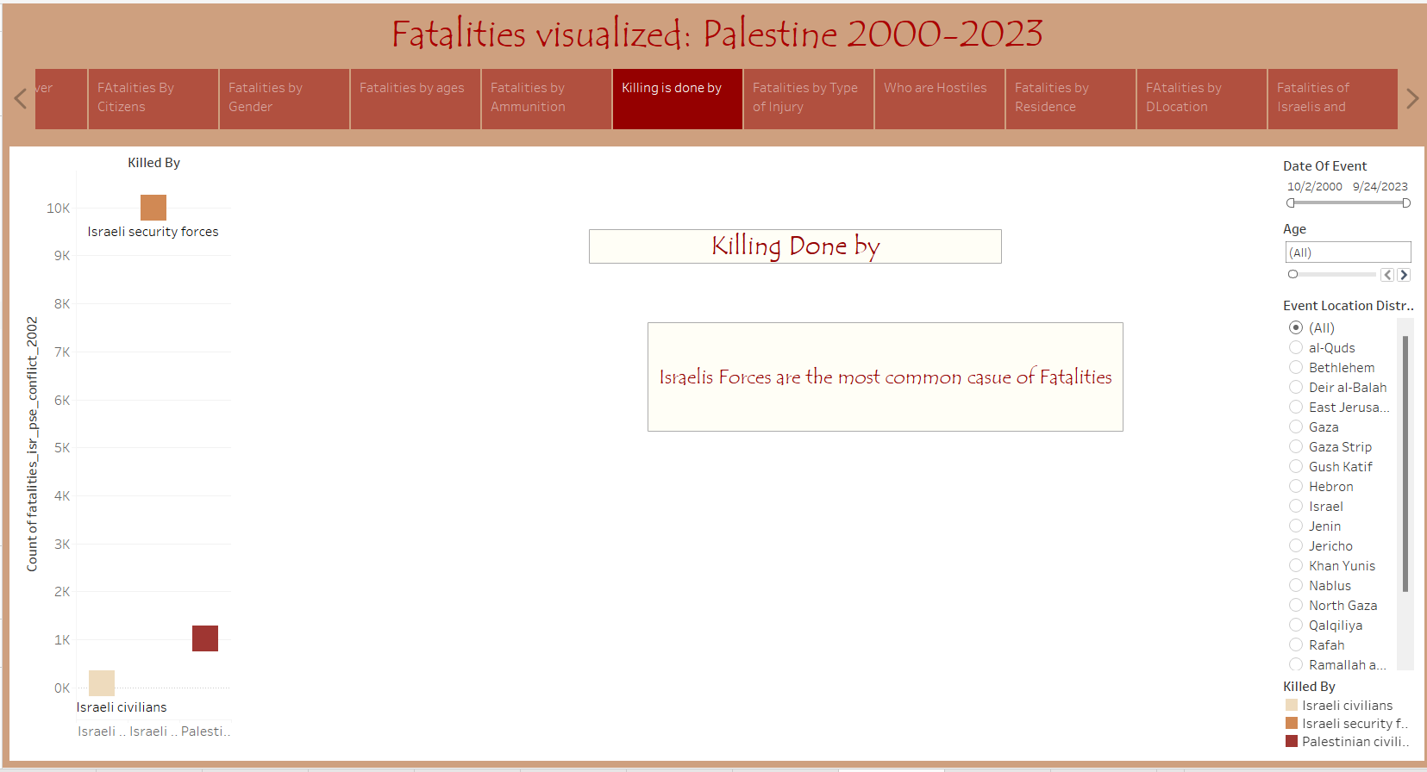
Killing is Done Majorly by ?
Israeli's forces are mostly behind all these fatalities. The number is almost 10,000 up till 2023.

Slide 9
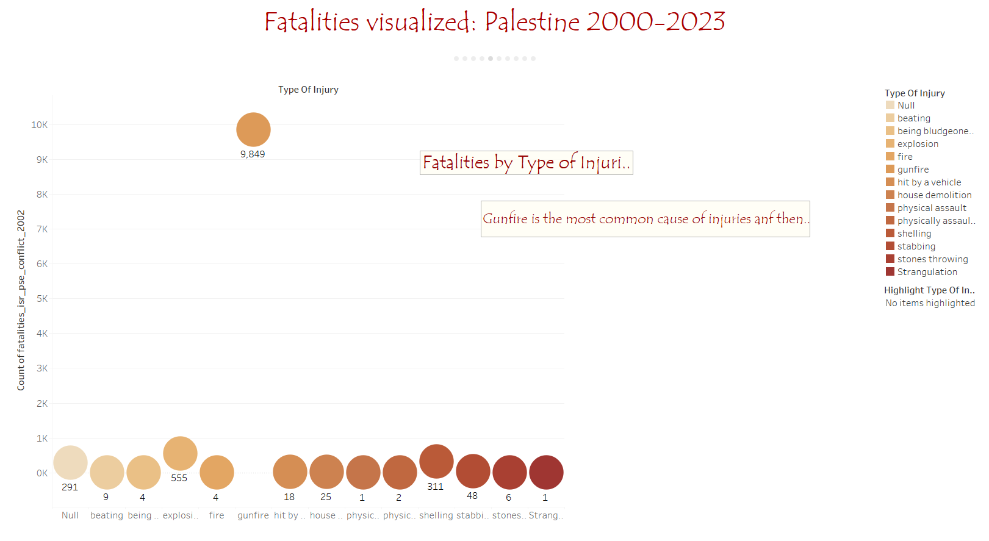
Fatalities over the Years by Type of Injuries.
While sudden deaths are common sometimes injuries can also lead to death. Over the years gunfire injuries have been the type of injury that has resulted in the eventual killings of the Palestinians.

Slide 10
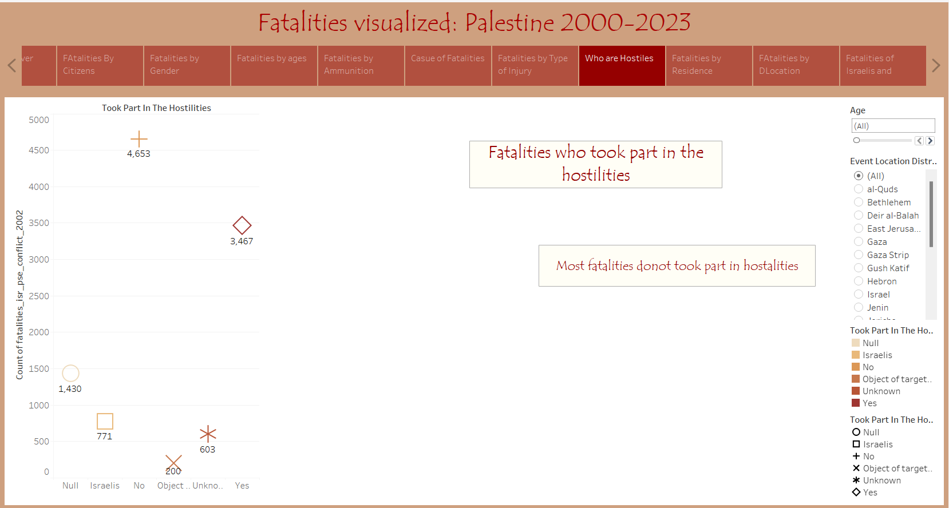
Fatalities are Happen Over Who Took Part in Hostilities.
Among the people who took part in the hostilities are Israelis. Israelis come on top when it comes to the hostilities from 2000 to 2023.
:

Slide 11
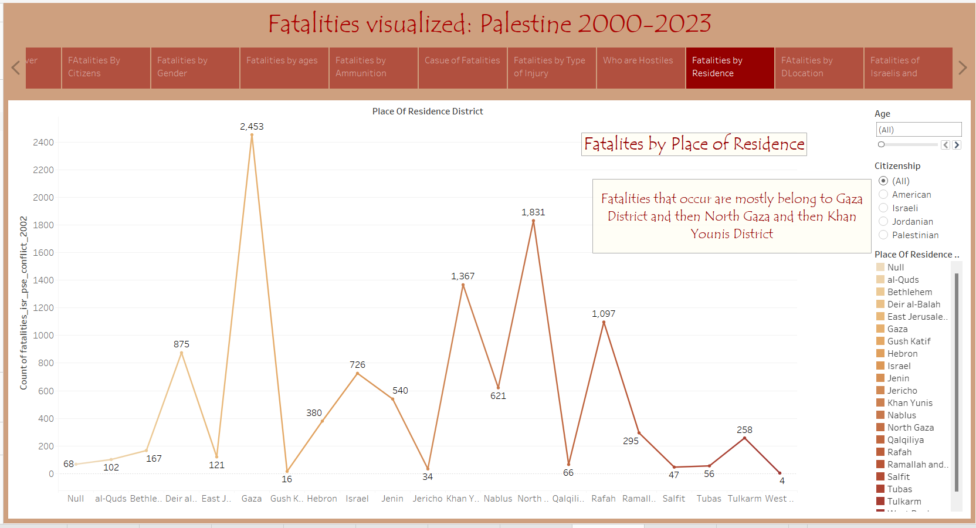
Fatalities Happen Over The Years and Their Place of Residence(District).
While the whole of Palestine is affected Fatalities and the attacks mostly occur in the Gaza District, North Gaza and the Khan Younis District. All of these regions are completely occupied by Israel.
In terms of the place that is the most targeted are residential buildings.

Slide 12
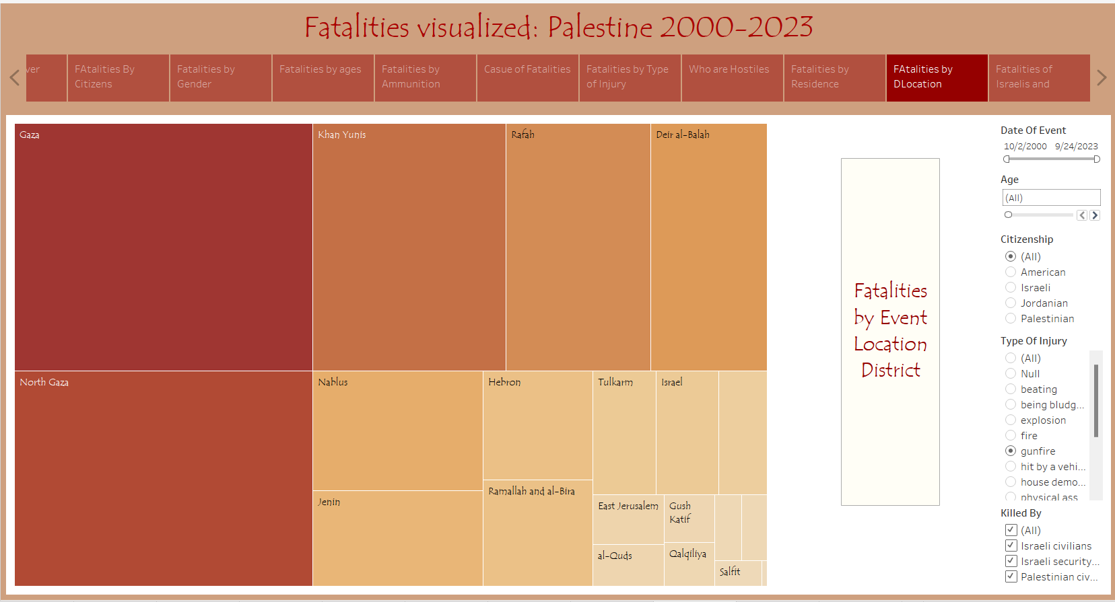
Fatalities over the Year by Location of Events (Districts) .
As mentioned before Gaza is one of the most heavily targeted region of Palestine. From 2000 to 2023 Gaza followed by North Gaza are the most targeted and heavily bombed areas of Palestine. Gaza was captured by Israel in 1967.

Slide 13
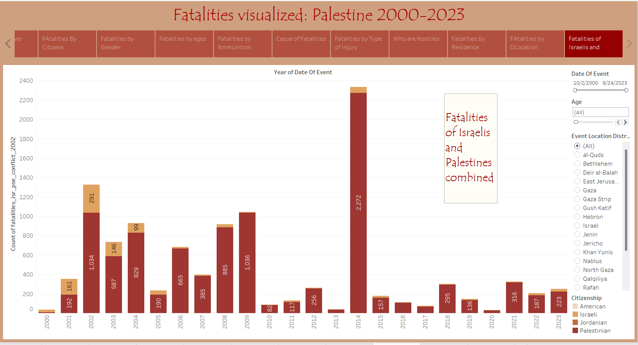
Fatalities are happened over The Years of Palestinian Citizens and Israelis combined.
If we were to combine the deaths of Palestinians and Israel from 2000 to 2023 we would see a clear difference in that number. Palestinian fatalities are far greater in number with 2014 peaking in the number of killings.
:

Slide 14

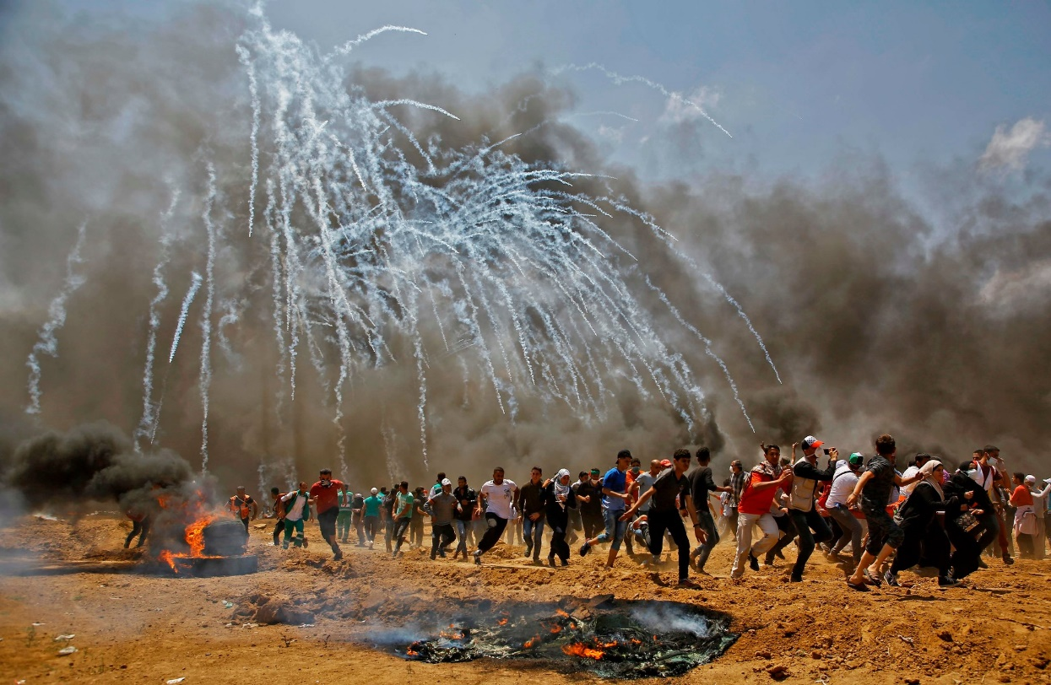
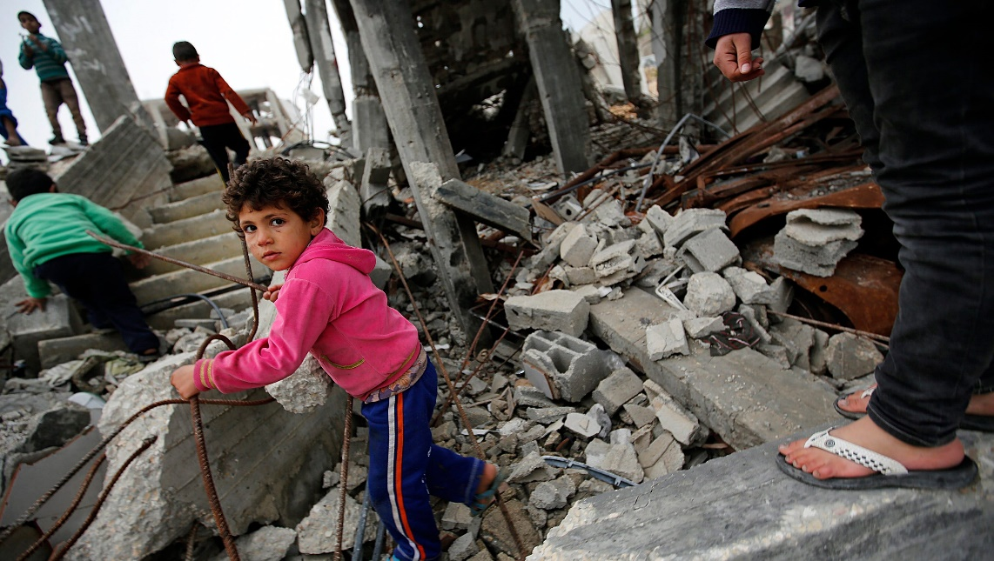
“We suffer from an incurable malady: Hope”
Mahmoud Darwish
The war is still going on and the number of fatalities are rising on daily basis and leaving behind the destruction and miseries. I hope it will end soon!

Slide 15
References:
Dataset:
https://www.kaggle.com/datasets/willianoliveiragibin/fatalities-in-the-israeli-palestinian
Images
https://ca.search.yahoo.com/yhs/search?p=palestine%20images&hspart=fc&hsimp=yhs-2461&type=fc_AC934C13286_s58_g_e_d110422_n9998_c999&param1=7&param2=eJwtjMEOgjAQRH9lj5oQ2BaopVz9Aq%2FEQ20XbCiUKAbj17tEM5c3szszBN%2B118tZIEqNqsuuM%2FumaTTjfhICKynZuF%2FOFBZGqfBkerLaVJJK0ztEI3wjjHK30lDtvdG13lcGSvzvLOPLMk3pE2K0RZ0jHLYw%2B7Q9YV5BYI4tcKCqFt6qOoJdlkgb3cawFnV5yksFh%2FG%2BTjGDGEaCgdyYjuDujzRRISQP7IKn7e0j%2FCtfTnxCxA%3D%3D
Quote:
https://www.azquotes.com/author/3659-Mahmoud_Darwish

